Slide 1

Alexander Souza
Pedro Mota
GESTURE BASED UI DEVELOPMENT
Application deployed on AWS and Heroku:
https://leapmapgmit.herokuapp.com
GitHub:
https://github.com/alexpt2000gmit/4Year_GESTURE_BASED_UI_DEVELOPMENT
YouTube:
https://youtu.be/g7kntVLHfjk

Slide 2
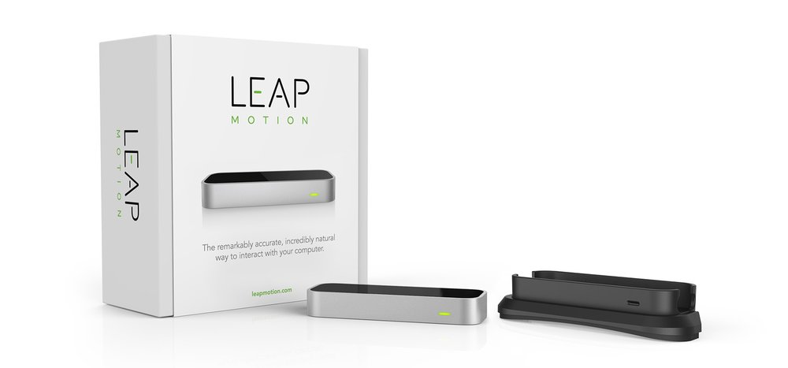
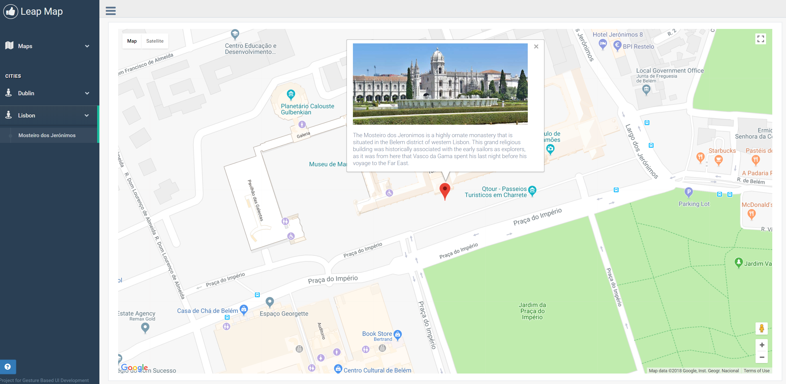
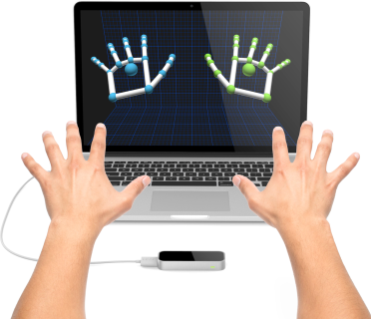
THE PROJECT
LeapStreetMap

Slide 3
The Application
The project is made up of the Leap Motion, Google Map & Street View, and HTML + JavaScript code for connecting the two of them.
The project allows a user to navigate Google Street View with only hand motions inside a web browser.

Slide 4





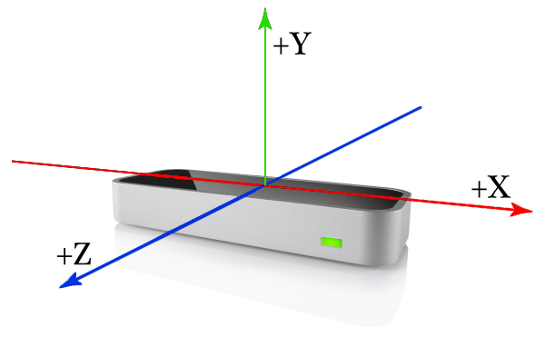
The Application
APIs
ARCHITECTURE / TECHNOLOGIES
Leap Motion API
Google Maps APIs
Front end
The best team is where
the best leader be
https://leapmapgmit.herokuapp.com

Slide 5


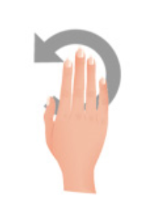
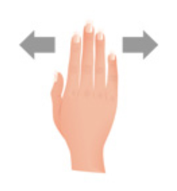


Functionality
Gestures
Change map (Map or Street View)
Closing hand into fist and moving fist allows movement in the map
Counter clockwise / Anticlockwise (zoom in and zoom out)
Close popup
Closed fist and forward movement to walk on Street View

Slide 6
Thanks ☺

